Slide 1


AIESEC surveyed over 300 companies
that work with us to develop youth talent.
This is what they said.

Slide 2
86%
“Hiring young people with an international background is extremely important for my company.“
52%
“ Educational institutes are giving youth what they need to be successful.“
Notes:
Brazil, colo, peru, italy, finland, indonesia

Slide 3
WHAT KIND OF EXPERIENCES STAND OUT TO EMPLOYERS?
74% - Foreign Languages Learned
73% - International Work Experience
64% - Volunteering
64% - University Background
51% - Exam Results

Slide 4
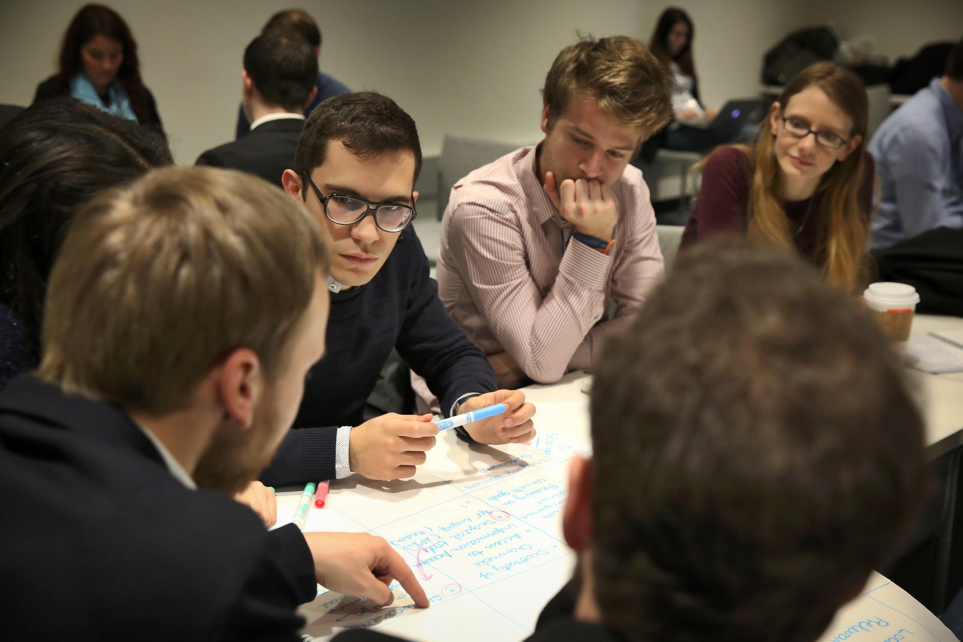



Slide 5




Intern this Summer // 6 -12 Weeks // 10 Country Partners
GAIN WORK EXPERIENCE ABROAD
GET TO KNOW NEW CULTURES
IMPROVE YOUR LANGUAGE SKILLS

Slide 6
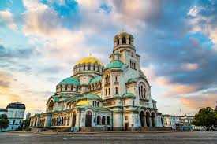
Game Marketing Manager
Sofia, Bulgaria // 11 Weeks
Great opportunity for you to develop your skills by helping to create the company's entire marketing strategy from scratch
Start-up is open for your ideas
Softwaredevelopement, programming
Housing and computer are provided.
The project begins on July 1th, 2018.
Learn More:
aiesec.org/opportunity/901537
Notes:
Where can I go:
LCs can enter their specific partner countries

Slide 7
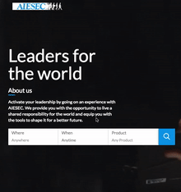
AIESEC.ORG
Sign-up
Create your profile on aiesec.org, and we will contact you to begin your search.
Search
Begin searching for a project from one of our partner countries.
Apply
Apply through the platform, with a form, or through an interview.
Prepare
Once you are accepted, you can pay your program fee and prepare your logistics!

Slide 8



Next Steps
Get to know us and learn more about the summer of your life
Tuesday 3pm-7pm
Hochschulgruppenhaus S203 - 5
AIESEC in Germany
aiesecingermany
aiesec.org

